Slide 1


Unit 4: Industrial Control Systems (ICS) Security
Mr. Rameez Raja,
Cyber Security Trainer

Slide 2


Syllabus
Introduction to Industrial Control Systems, Security Measures for SCADA Systems, Securing PLCs and RTUs, ICS Security Best Practices

Slide 3
Introduction to Industrial Control Systems
Industrial Control Systems (ICS) are specialized systems designed to manage and control industrial processes and machinery in sectors such as manufacturing, energy, transportation, and utilities. These systems are crucial for ensuring the efficient operation of complex industrial processes, optimizing productivity, and maintaining safety standards.
Here's a brief introduction to Industrial Control Systems:
1. Purpose: The primary purpose of ICS is to monitor, control, and automate industrial processes. This can include tasks like regulating temperature, pressure, flow rates, and other variables crucial to production.
2. Components:
Sensors and Actuators: Sensors detect changes in physical variables like temperature, pressure, or humidity, while actuators perform actions based on control signals, such as adjusting valves or motors.
Control Units: These are the brains of the system, processing sensor data and issuing commands to actuators based on pre-defined logic or algorithms.

Slide 4
Introduction to Industrial Control Systems
Human Machine Interface (HMI): This component provides a way for operators to interact with the system, often through graphical interfaces that display real-time data and allow for manual control overrides.
Networking Infrastructure: Many modern ICS are connected through networks, allowing for remote monitoring and control, as well as integration with other systems such as enterprise resource planning (ERP) software.
3. Types of Industrial Control Systems:
Supervisory Control and Data Acquisition (SCADA) Systems
Programmable Logic Controllers (PLC)
Remote Terminal Units (RTUs)
Distributed Control Systems (DCS)

Slide 5
Supervisory Control and Data Acquisition (SCADA) Systems
SCADA:
Supervisory Control and Data Acquisition (SCADA) systems are a type of Industrial Control System (ICS) used in various industries to monitor, control, and manage complex processes and equipment. Here's a detailed concept of SCADA systems:
Overview:
SCADA systems provide a centralized platform for monitoring and controlling industrial processes across multiple sites or locations.
They integrate hardware and software components to collect data from sensors and devices, analyze it, and provide operators with real-time insights for decision-making.
SCADA systems are commonly used in industries such as energy (power generation and distribution), water and wastewater management, oil and gas, transportation (e.g., traffic control), and manufacturing.

Slide 6
Supervisory Control and Data Acquisition (SCADA) Systems
Components:
Remote Terminal Units (RTUs) or Programmable Logic Controllers (PLCs): These are field devices responsible for interfacing with sensors and actuators, collecting data, and executing control commands. RTUs and PLCs send data to the SCADA system for processing.
Human-Machine Interface (HMI): The HMI is the user interface through which operators interact with the SCADA system. It typically includes graphical displays, alarm notifications, and control interfaces.
Supervisory System: This is the core software component of the SCADA system, responsible for data acquisition, processing, and control. It communicates with RTUs/PLCs, collects data, and provides real-time visualization and control capabilities.
Communication Infrastructure: SCADA systems rely on communication networks (e.g., LAN, WAN, serial communication) to connect field devices to the supervisory system. These networks can be wired or wireless, depending on the application requirements.

Slide 7
Supervisory Control and Data Acquisition (SCADA) Systems
Functionality:
Data Acquisition: SCADA systems continuously collect data from sensors and devices in the field, such as temperature, pressure, flow rates, and equipment status.
Visualization: They provide real-time visualization of process data through graphical displays, trends, and alarm notifications. Operators can monitor the status of equipment and processes from a centralized location.
Control: SCADA systems allow operators to control industrial processes remotely by sending commands to RTUs/PLCs. This includes adjusting setpoints, opening or closing valves, and starting or stopping equipment.
Data Storage and Analysis: SCADA systems store historical data for analysis and reporting purposes. They can generate reports, trends, and performance indicators to support decision-making and optimize processes.
Alarm Management: SCADA systems monitor for abnormal conditions and trigger alarms when predefined thresholds are exceeded. Operators can respond to alarms promptly to prevent downtime or safety hazards.

Slide 8
Supervisory Control and Data Acquisition (SCADA) Systems
Security:
Security is a critical aspect of SCADA systems due to their integration with external networks and potential vulnerabilities to cyber threats.
Measures such as firewalls, authentication mechanisms, encryption, and network segmentation are implemented to protect SCADA systems from unauthorized access and cyber-attacks.
Compliance with industry standards and best practices (e.g., NIST, ISA/IEC 62443) is essential for ensuring the security of SCADA systems.

Slide 9
Supervisory Control and Data Acquisition (SCADA) Systems
Applications:
SCADA systems have diverse applications across industries, including:
Monitoring and control of power generation and distribution networks.
Management of water and wastewater treatment plants.
Oil and gas pipeline monitoring and control.
Traffic control and management in transportation systems.
Manufacturing process control and automation.

Slide 10
PLCs
PLC:
Programmable Logic Controllers (PLCs) are ruggedized digital computers widely used in industrial automation to control manufacturing processes, machinery, and equipment. Here's a detailed overview of PLCs:
Definition:
A PLC is a specialized industrial computer designed to perform control functions based on user-programmed logic.
PLCs are programmable, meaning their behavior can be configured and customized to meet specific automation requirements.

Slide 11
PLCs
Components:
Central Processing Unit (CPU): The CPU is the core component of the PLC, responsible for executing control programs, processing inputs, and generating outputs.
Input Modules: PLCs are equipped with input modules that interface with sensors, switches, and other devices to receive signals indicating the state of the controlled process.
Output Modules: PLCs contain output modules that interface with actuators, motors, valves, and other devices to control the operation of the controlled process.
Memory: PLCs have various types of memory, including program memory (for storing control logic), data memory (for storing variables and intermediate results), and system memory (for internal operations).
Communication Interfaces: PLCs may include communication ports for connecting to other devices, such as human-machine interfaces (HMIs), supervisory control systems (SCADA), or other PLCs.
Power Supply: PLCs require a stable power supply to operate, which may be provided by an external power source or through internal power modules.

Slide 12
PLCs
Programming Languages:
PLCs can be programmed using various programming languages, including:
Ladder Logic: A graphical programming language resembling electrical relay diagrams, commonly used for sequential control applications.
Structured Text (ST): A high-level programming language resembling Pascal or C, suitable for complex algorithmic control logic.
Function Block Diagram (FBD): A graphical programming language based on interconnected function blocks representing control functions.
Sequential Function Chart (SFC): A graphical programming language used for defining sequential control sequences and state-based control logic.
PLC programming languages are chosen based on the complexity of the control logic, the familiarity of the programming team, and the requirements of the application.

Slide 13
PLCs
Functions:
Input Processing: PLCs continuously monitor input signals from sensors and switches, detecting changes in the state of the controlled process.
Control Logic Execution: PLCs execute the user-programmed control logic stored in their memory, determining the appropriate actions to take based on input signals and internal logic.
Output Generation: PLCs generate output signals to control actuators, motors, valves, and other devices, ensuring the desired operation of the controlled process.
Data Handling: PLCs can store and manipulate data, such as variables, timers, counters, and flags, to implement advanced control algorithms and logic.
Communication: PLCs support communication with other devices and systems, enabling integration with higher-level control systems, data logging, and remote monitoring.

Slide 14
PLCs
Applications:
PLCs are used in a wide range of industries and applications, including manufacturing, automotive, aerospace, energy, food and beverage, pharmaceuticals, and more.
Common applications include:
Control of conveyor systems, assembly lines, and robotic arms in manufacturing.
Monitoring and control of industrial processes such as heating, cooling, mixing, and filling.
Control of machinery and equipment in power plants, refineries, and water treatment facilities.
Building automation systems for controlling HVAC (heating, ventilation, and air conditioning), lighting, and security systems.
Control of traffic signals, elevators, and escalators in transportation systems.

Slide 15
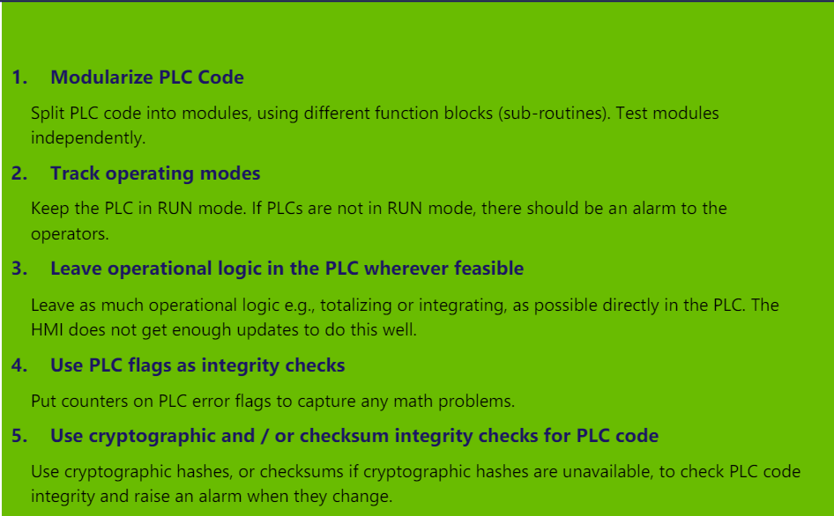
How to Secure PLCs (Secure PLC Coding Practices: Top 10 List)

Slide 16
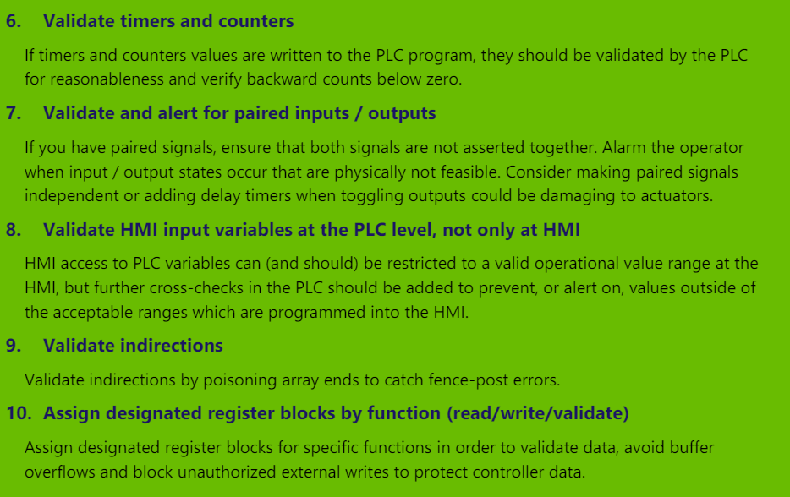
How to Secure PLCs (Secure PLC Coding Practices: Top 10 List)

Slide 17
RTUs
RTUs:
Remote Terminal Units (RTUs) are integral components of Supervisory Control and Data Acquisition (SCADA) systems and other industrial control systems (ICS). Here's a detailed look at RTUs:
Definition:
An RTU is a specialized device used in industrial automation to monitor, gather, and transmit data from sensors and control equipment located in remote or harsh environments.
RTUs act as intermediaries between field devices (such as sensors, actuators, and switches) and the central SCADA or control system.

Slide 18
RTUs
Components:
Input Channels: RTUs are equipped with multiple input channels to connect to sensors and other field devices. These channels can accept analog signals (e.g., temperature, pressure) or digital signals (e.g., on/off status).
Output Channels: RTUs may also include output channels to control actuators or relays based on commands received from the central control system.
Processing Unit: RTUs contain a microprocessor or controller that processes input signals, executes control algorithms, and communicates with the central system.
Communication Interfaces: RTUs are equipped with communication interfaces (e.g., serial ports, Ethernet, wireless) to connect to the central SCADA system or other control devices.
Power Supply: RTUs require a power source to operate, which may be provided through external power sources, batteries, or solar panels in remote locations.
Enclosure: RTUs are typically housed in ruggedized enclosures designed to withstand harsh environmental conditions such as temperature extremes, humidity, and dust.

Slide 19
RTUs
Functions:
Data Acquisition: RTUs continuously collect data from connected sensors and devices, such as temperature, pressure, flow rates, and equipment status.
Data Processing: RTUs may perform basic processing of acquired data, such as scaling, filtering, or averaging, before transmitting it to the central control system.
Control: RTUs can execute control commands received from the central control system, such as opening or closing valves, starting or stopping pumps, or adjusting setpoints.
Communication: RTUs establish communication links with the central SCADA or control system, transmitting acquired data and receiving control commands.
Local Control: In some applications, RTUs may also support local control functions, allowing for autonomous operation without constant communication with the central system.

Slide 20
RTUs
Applications:
RTUs are used in various industries and applications where remote monitoring and control of industrial processes are required.
Common applications include:
Monitoring and control of oil and gas pipelines.
Remote monitoring of electric power distribution networks.
Supervision of water and wastewater treatment plants.
Environmental monitoring in remote locations.
Remote monitoring and control of equipment in agriculture and mining operations.
Integration with SCADA Systems:
RTUs are essential components of SCADA systems, providing the data acquisition and control capabilities necessary for remote monitoring and control of industrial processes.
RTUs communicate with the central SCADA system over communication networks, transmitting acquired data and receiving control commands to ensure coordinated operation.

Slide 21
How to secure RTUs
With increased automation of remote monitoring systems, the impacts of these attacks on your elements could impact your critical operations. Because of that, it's vital that you make sure your data is confidential and that unauthorized people can't access it.
Following are principle which are responsible for security of RTU:
1. RADIUS Authentication Feature
2. SNMPv3 Encryption Feature
3. HTTPS
4. Proxy Ports Password Protection
5. Multiple NICs Security Model
For detail explanation of Above points visit this Article:
https://www.dpstele.com/blog/top-five-security-features-of-an-rtu.php

Slide 22
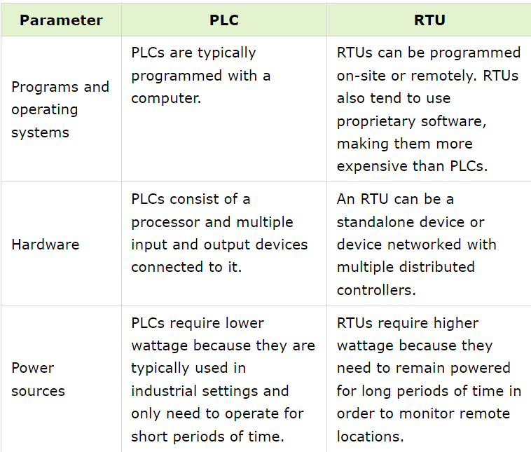
PLCs vs RTUs

Slide 23
ICS Security Best Practices
Network Segmentation:
Segment the ICS network into zones based on functionality and security requirements.
Implement firewalls, routers, and access control lists to control traffic between zones and prevent unauthorized access.
Secure Remote Access:
Limit remote access to ICS networks and systems to authorized personnel only.
Use secure methods such as VPNs (Virtual Private Networks) with strong authentication mechanisms for remote access.
Implement multi-factor authentication to enhance security.
Patch Management:
Regularly apply security patches and updates to ICS components, including PLCs, RTUs, HMIs, and SCADA systems.
Use a systematic approach to assess and test patches for compatibility and potential impact on system operation before deployment.

Slide 24
ICS Security Best Practices
Secure Configuration:
Follow vendor recommendations and industry best practices for securely configuring ICS components.
Disable unnecessary services, protocols, and ports to reduce the attack surface.
Change default passwords and credentials to strong, unique ones.
Access Control:
Implement strong access control mechanisms to restrict access to ICS systems and data based on the principle of least privilege.
Use role-based access control (RBAC) to assign permissions to users based on their job responsibilities.
Monitor and audit user activities to detect and respond to unauthorized access attempts.
Continuous Monitoring:
Deploy intrusion detection systems (IDS) and intrusion prevention systems (IPS) to monitor ICS networks for signs of unauthorized access, malware, or unusual behavior.
Implement security information and event management (SIEM) solutions to centralize and analyze security logs from ICS components and network devices.

Slide 25
ICS Security Best Practices
Physical Security:
Implement physical security measures to protect critical ICS components, such as PLCs, RTUs, and SCADA systems, from unauthorized access or tampering.
Secure access to ICS facilities, control rooms, and equipment rooms using locks, access controls, and surveillance systems.
Incident Response:
Develop and implement an incident response plan specifically tailored to ICS security incidents.
Define procedures for detecting, containing, and recovering from security breaches or disruptions to ICS operations.
Conduct regular drills and exercises to test the effectiveness of the incident response plan.

Slide 26
ICS Security Best Practices
Security Awareness Training:
Provide comprehensive security awareness training to all personnel involved in operating, maintaining, and securing ICS environments.
Educate employees about common security threats, best practices for secure behavior, and the importance of reporting security incidents promptly.
Regulatory Compliance:
Ensure compliance with relevant industry standards and regulations governing ICS security, such as NIST SP 800-82, ISA/IEC 62443, and NERC CIP.
Regularly assess and audit ICS security controls to demonstrate compliance and identify areas for improvement.

Slide 27


www.paruluniversity.ac.in

